Slide 1
ADMINISTRATIVE PERMIT CASE NUMBER WADMIN19-0001
(Matt and Angie Bussell Detached Accessory Structure)
Washoe County Board of Adjustment
March 7, 2019

Slide 2
Request
Detached Accessory Structure 2000 square feet in size
The main dwelling on the parcel, is 1538 square feet in size.
Kit Pole Building for Agricultural and Storage Use

Slide 3
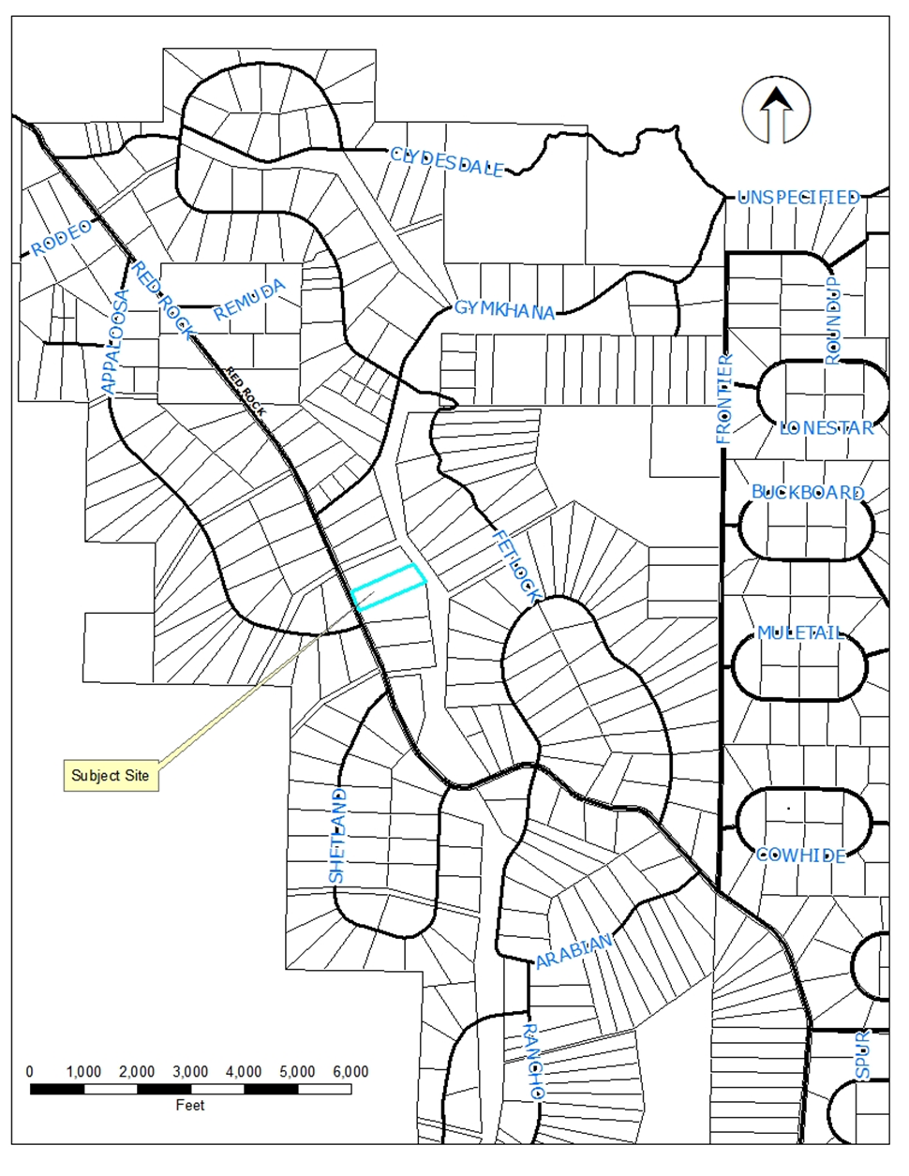
Project Location

Slide 4
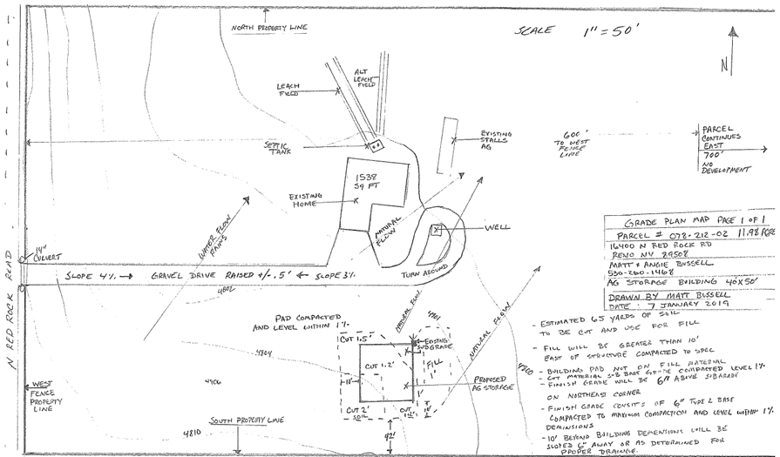
Site Plan

Slide 5
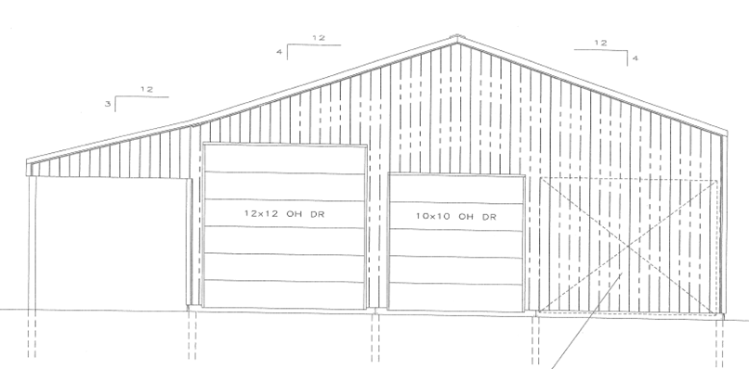
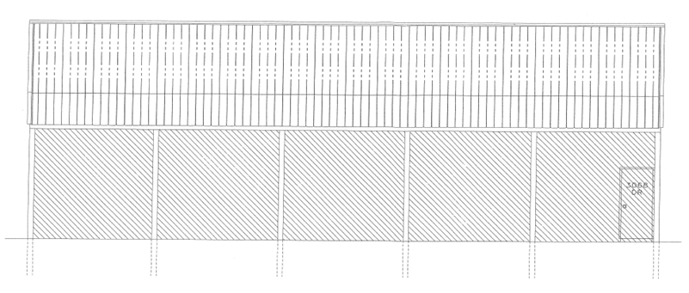
Proposed Elevations

Slide 6
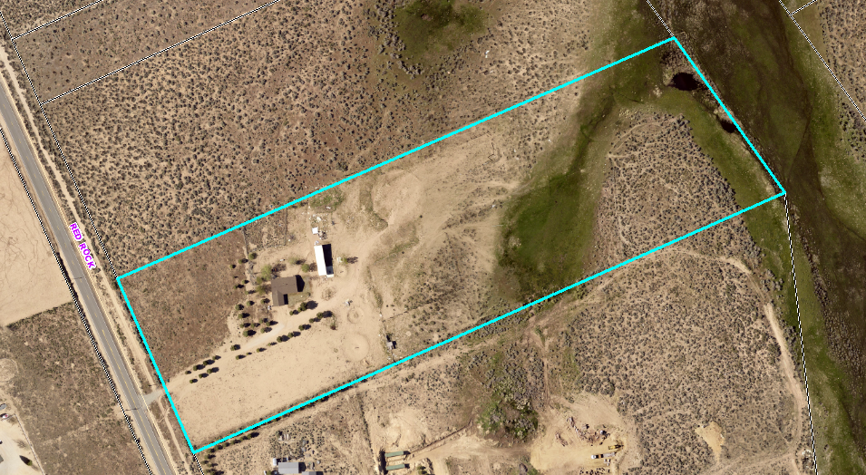
Overhead Photo

Slide 7
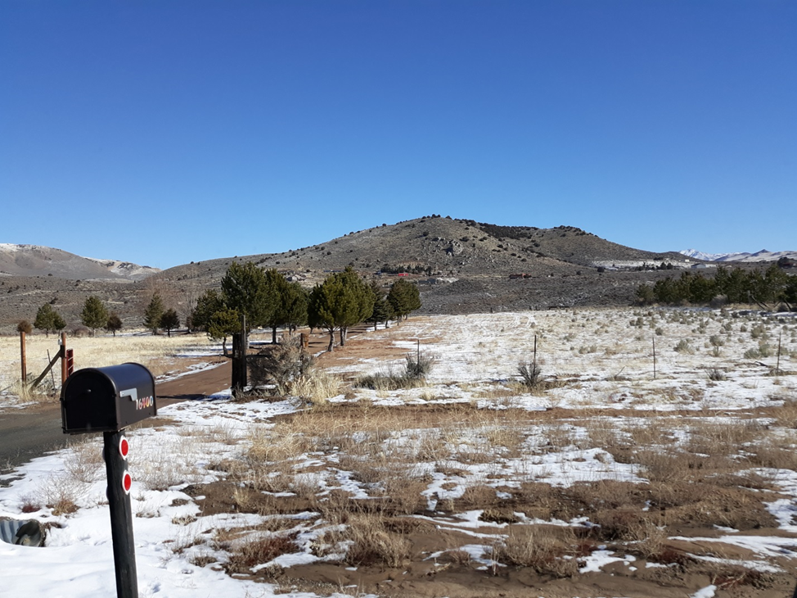
Site Photo

Slide 8
Project Evaluation
within the allowed building height for the LDR regulatory zone
architecturally compatible with surrounding development patterns
proposed to be painted the same color as the dwelling on the same parcel of land
no significant topography

Slide 9
Citizen Advisory Board
The proposed project was presented by the applicant’s representative at the regularly scheduled Citizen Advisory Board meeting on February 11, 2019. The CAB took action to recommend approval of the administrative permit as requested. No concerns were expressed by the CAB.

Slide 10
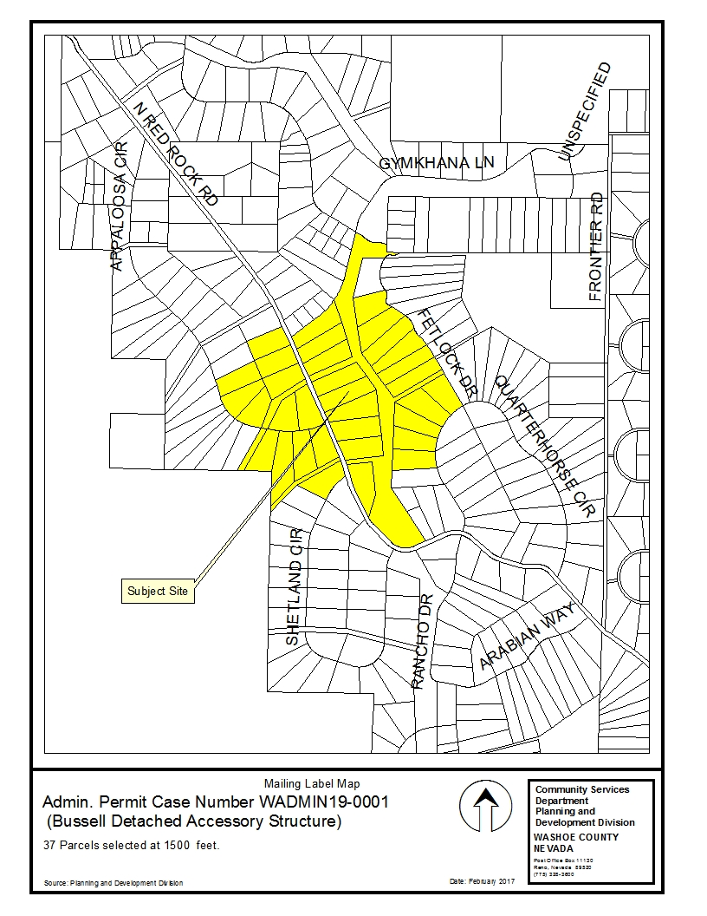
Public Notice
Notice sent to owners of 37 parcel of land
Distance of 1500 feet

Slide 11
Administrative Permit Findings
Consistency
Improvements
Site Suitability
Issuance Not Detrimental
Effect on a Military Installation (None)
Staff Comments are found on pages 7 & 8 of the staff report.
Staff believes that all findings can be made.

Slide 12
Possible Motion
I move that, after giving reasoned consideration to the information contained in the staff report and information received during the public hearing, the Board of Adjustment approve, with conditions, Administrative Permit Case Number WADMIN19-0001 for Matt and Angie Bussell, having made all five findings in accordance with Washoe County Development Code Section 110.808.25

